Slide 1

MOUNT ZION COLLEGE OF ENGINEERING AND TECHNOLOGY PUDUKKOTTAI
AI-POWERED E-COMMERCE CHATBOT USING NLP
AND SEMANTIC SEARCH
TEAM MEMBERS
JASMINE K – 911722104047
AARTHI C – 911722104002
BUVANESWARI C – 911721104018
GAYATHRI B – 911722104036
GUIDED BY
Mrs.D.ELAVARASI M.E.,PHD
AP/CSE

Slide 2
ABSTRACT
This project presents an AI-powered E-commerce Chatbot integrated with a Fresh Chat interface, designed to provide intelligent product recommendations and automated customer support. The system uses Sentence Transformers to generate semantic embeddings of product descriptions and stores them in a PostgreSQL database with pgvector extension. When users interact through the Fresh Chat interface, their queries are converted into embeddings and matched using vector similarity search to retrieve relevant products. An open-source LLM generates natural, human-like responses. This approach improves search precision, personalization, and customer experience in e-commerce platforms.

Slide 3
INTRODUCTION
Modern e-commerce platforms require intelligent conversational systems to improve user engagement and product discovery.
Traditional keyword-based search lacks contextual understanding.
This project introduces a chatbot integrated with a Fresh Chat interface, powered by semantic search using pgvector and LLM-based conversational AI to provide accurate recommendations and automated support.

Slide 4
AIM AND OBJECTIVES
Aim
To develop an AI-powered e-commerce chatbot that can understand user queries using Natural Language Processing and semantic search techniques, and provide accurate, relevant, and human-like responses to improve user interaction and automate customer support.
Objectives
Develop a chatbot integrated with Fresh Chat interface.
Implement semantic search using pgvector.
Generate embeddings using Sentence Transformers.
Provide intelligent product recommendations.
Automate customer support using open source LLM.

Slide 5
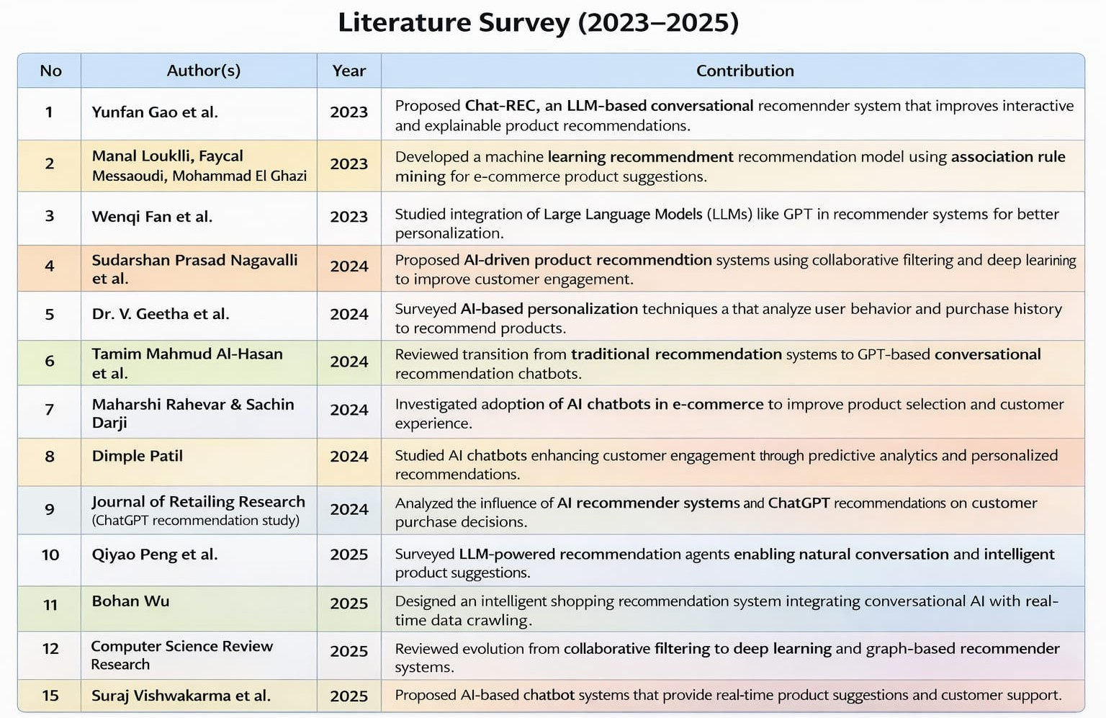
LITERATURE SURVEY

Slide 6
PROBLEMS IDENTIFIED
Keyword-based search fails to understand user intent.
Traditional chatbots provide limited rule based responses.
Customers receive irrelevant recommendations.
Lack of integration between conversational AI and semantic product search

Slide 7
EXISTING SYSTEM
The existing system in most e-commerce platforms is based on keyword-based SQL search, static FAQ chatbots, and manual recommendation systems.
These systems match user queries with exact keywords in the database, which often leads to irrelevant results when the wording of the query changes.
Static chatbots provide predefined responses and fail to handle variations or complex queries. Manual recommendation systems do not consider user preferences dynamically, resulting in generic suggestions.
Additionally, the system lacks semantic understanding and does not use vector similarity search, making it unable to interpret user intent effectively.
Overall, the existing system is limited, less flexible, and unable to provide accurate and personalized responses.

Slide 8
DISADVANTAGES
Traditional systems don't cover large or remote areas well.
Take a long time to collect, transport, and analyze samples
Relying on fixed stations leading to uneven coverage.
Machine learning algorithms lead to inaccurate predictions.
Computational Complexity.
ML models need large, high-quality datasets for accuracy.

Slide 9
PROPOSED SYSTEM
The proposed system integrates:
Fresh Chat interface for user interaction Django backend for processing logic Sentence Transformer for embedding generation PostgreSQL with pgvector for semantic similarity search.
Open-source LLM for natural response generation .
This enables context-aware product search and conversational support.

Slide 10
ADVANTAGES
Understands user intent using semantic embeddings instead of basic keyword matching.
Retrieves accurate products using vector similarity (pgvector), reducing irrelevant results.
Chatbot + LLM provides natural, human-like interaction instead of static search results.
Django + PostgreSQL enables fast processing and handles large product datasets effectively.

Slide 11
SOFTWARE REQUIREMENTS
Language :Python 3.10+
Design : HTML, CSS, Bootstrap
IDE : VS Code / PyCharm
Web Framework: Django
Database : PostgreSQL (Supabase)
Web Server : Django Development Server / Render (for deployment)
API : Fresh Chat API (for chatbot integration)
Packages : Sentence Transformers, Transformers (HuggingFace), Psycopg2, Django ORM, Pandas, NumPy

Slide 12
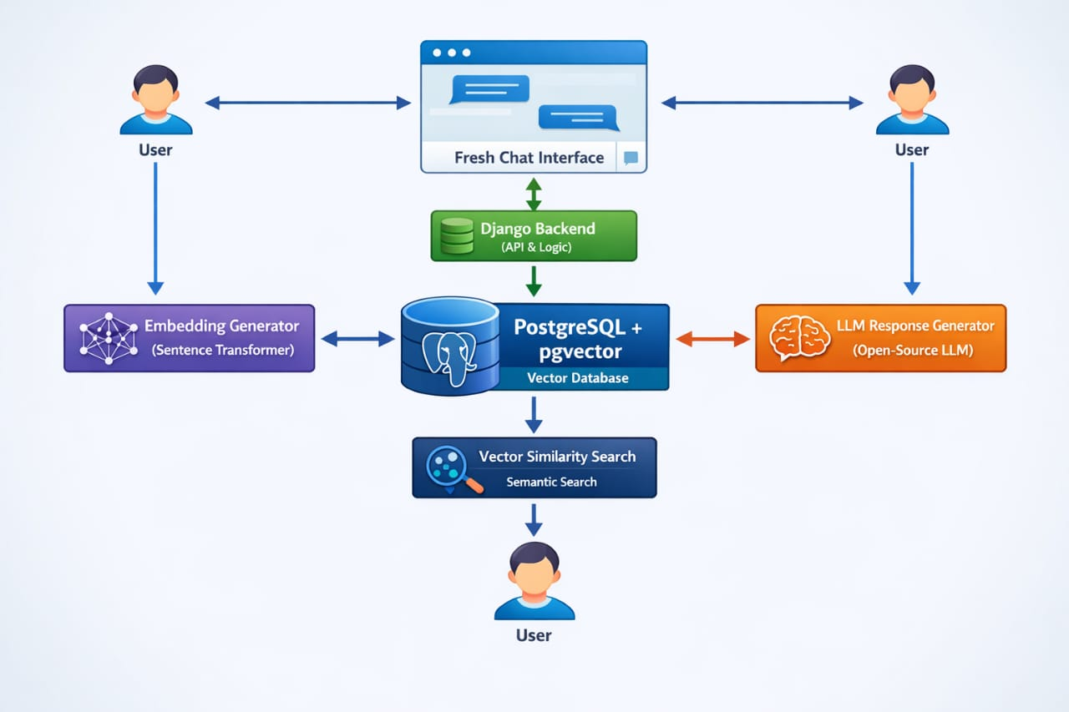
SYSTEM ARCHITECTURE

Slide 13
MODULES
LIST OF MODULES
User Interaction Module
Query Processing Module
Embedding Generation Module
Semantic Search Module
Recommendation Engine
LLM-Based Response Generation Module
Database Management Module

Slide 14
1. User Interaction Module
This module provides the interface for users to interact with the system through a chatbot (Fresh Chat). Users can enter natural language queries to search for products. It captures user input and displays responses in a conversational format. This module ensures a simple and user-friendly experience.
2. Query Processing Module
This module receives and processes user queries from the chatbot interface. It performs basic text cleaning and prepares the query for further processing.
The processed query is structured for embedding generation. It acts as the bridge between user input and AI-based processing.

Slide 15
3. Embedding Generation Module
This module converts textual data into numerical vector representations. It uses a pre-trained Sentence Transformer model (all-MiniLM-L6-v2). Both product data and user queries are transformed into embeddings. These embeddings capture semantic meaning for accurate comparison.
4. Semantic Search Module
This module performs similarity search using vector embeddings. It compares user query embeddings with stored product embeddings. Cosine similarity is used to find the most relevant products. It retrieves top-K matching results from PostgreSQL (pgvector).

Slide 16
5. Recommendation Module
This module refines the retrieved results to improve relevance. It considers factors like similarity score, rating, and product details. Products are ranked and filtered for better recommendation quality. It ensures users receive meaningful and useful suggestions.
6. Response Generation Module (LLM)
This module generates human-like responses using an open-source LLM. It takes relevant product data and user query as input. The output is formatted into a conversational response. This enhances user interaction and overall experience.

Slide 17
7. Database Management Module
This module handles storage and retrieval of system data. It uses PostgreSQL (Supabase) with pgvector for embedding storage. It manages product details, customer data, and reviews. Ensures efficient data access and supports semantic search operations.

Slide 18
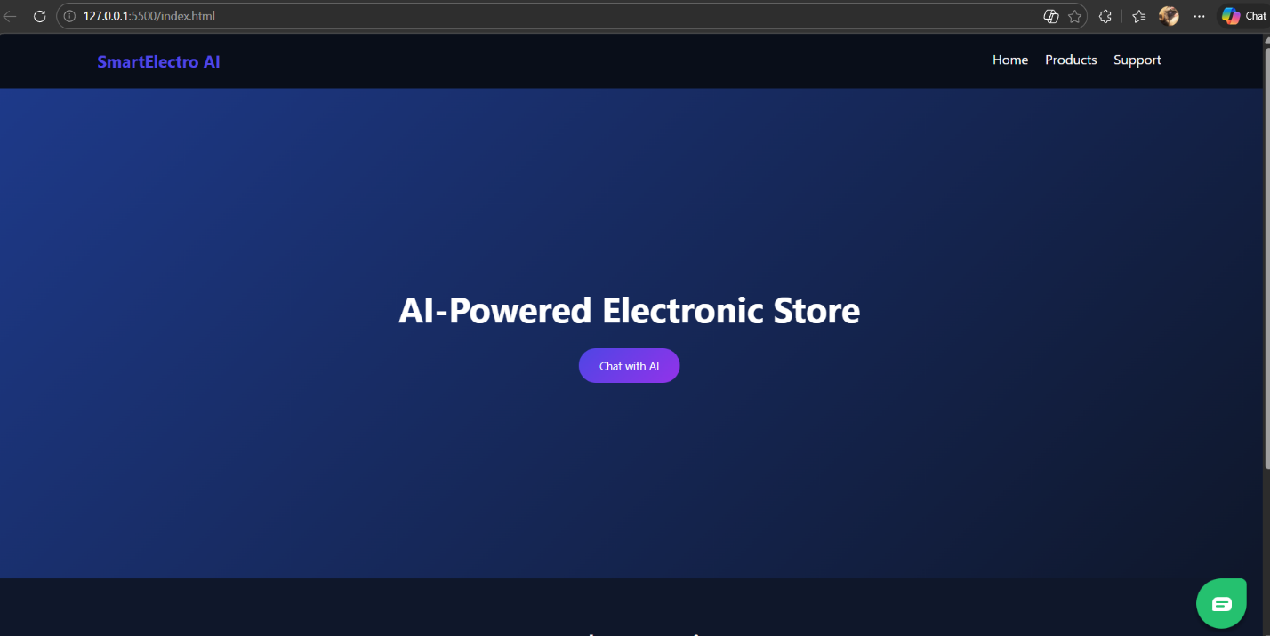
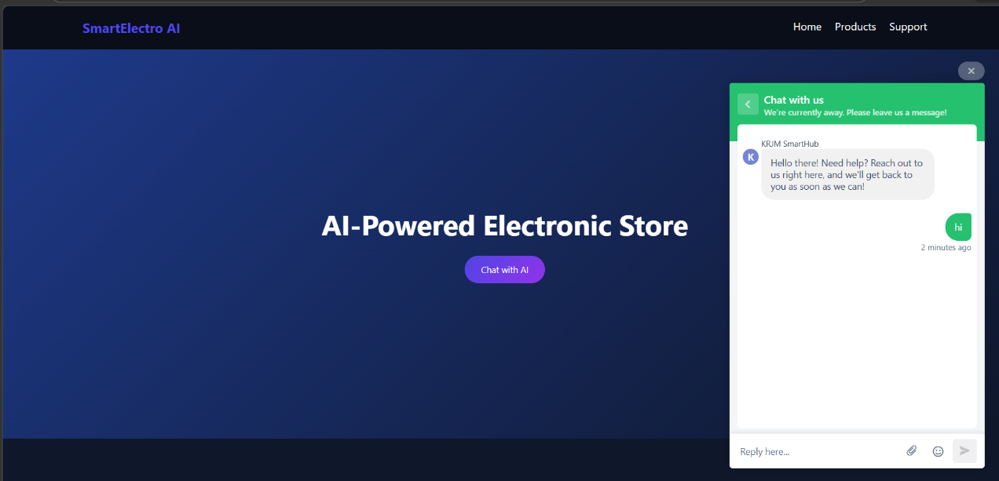
SAMPLE SCREENSHOTS

Slide 19
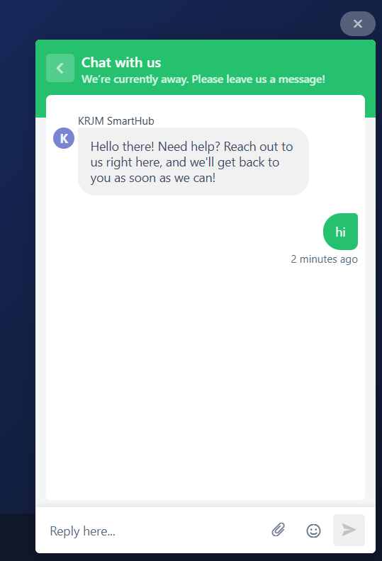
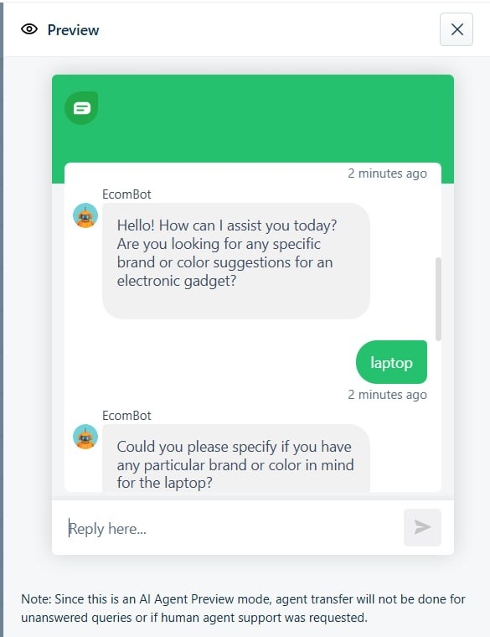
SAMPLE SCREENSHOTS

Slide 20
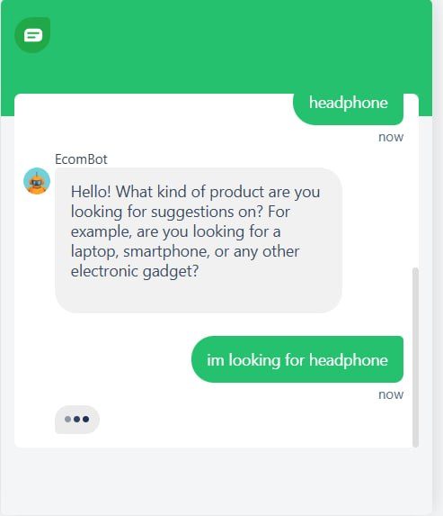
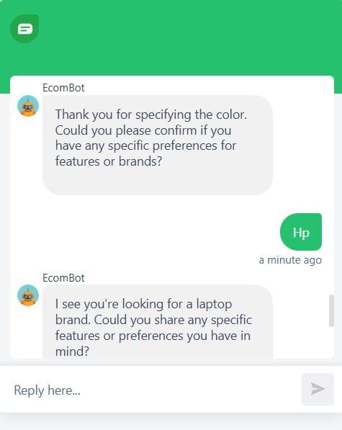
SAMPLE SCREENSHOTS

Slide 21
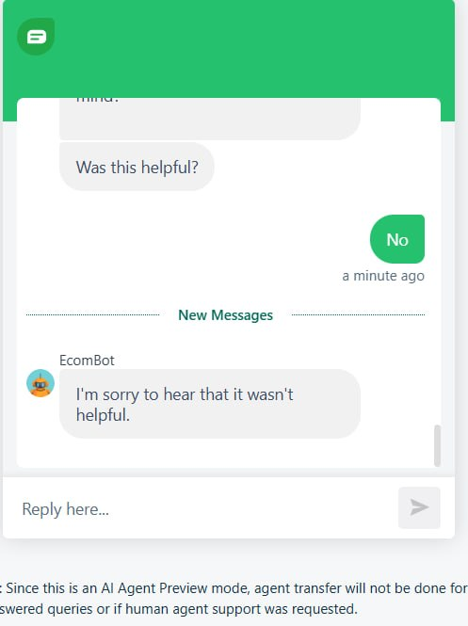
SAMPLE SCREENSHOTS

Slide 22
CONCLUSION
Traditional e-commerce systems often fail to provide relevant results due to their reliance on keyword-based search. This project presented an AI-powered e-commerce chatbot that uses semantic search and conversational AI to improve product discovery and user interaction. A Sentence Transformer model is used to generate embeddings for products and user queries, enabling context-aware similarity search using PostgreSQL with pgvector.
The system effectively retrieves relevant products based on user intent and generates natural responses using an open-source LLM. Compared to traditional methods, the proposed system improves recommendation accuracy, response quality, and overall user experience. It provides a scalable and efficient solution for intelligent product recommendation in modern e-commerce platforms.

Slide 23
FUTURE SCOPE
Integration of User Behavior Data Enhance the system by incorporating user browsing history and preferences to provide more personalized and adaptive product recommendations.
Multi-Language Chatbot Support Extend the chatbot to support multiple languages, enabling wider accessibility and improved user interaction across diverse user groups.
Mobile Application Development Develop a mobile application that allows users to interact with the chatbot, search products, and receive recommendations in real time.
Fine-Tuned Domain-Specific LLM Improve response quality by fine-tuning the language model on
e-commerce-specific data for more accurate and context-aware conversation.

Slide 24
REFERENCES
Beyari, Hasan. "Artificial intelligence’s effect on customer loyalty in the context of electronic commerce." Journal of Umm Al-Qura University for Engineering and Architecture 16, no. 3 (2025): 617-626.
Valencia-Arias, Alejandro, Hernán Uribe-Bedoya, Juan David González-Ruiz, Gustavo Sánchez Santos, Edgard Chapoñan Ramírez, and Ezequiel Martínez Rojas. "Artificial intelligence and recommender systems in e-commerce. Trends and research agenda." Intelligent Systems with Applications 24 (2024): 200435.
Chamapti, Santilata, Bijayini Moahanty, and Swadhin Kumar Barisa. "MLDSS: customer-centric retail recommendation via multi-layered decision support system." IEEE Access (2025).

Slide 25
REFERENCES
4. WięCkowski, Jakub, Andrii Shekhovtsov, Bogdan Franczyk, Jarosław Watróbski, and Wojciech Sałabun. "Personalized decision support enhanced by multiple expected solution points in the characteristic objects method." IEEE Access 13 (2024): 8355-8374.
5. Siddique, Nida, Amna Zafar, Beenish Ayesha Akram, Muhammad Waseem, Sajid Iqbal, Ahmad Al-Yahya, Muhammad Nabeel Asghar, and Abdullah Abdurrehman Alaulamie. "IMETA-GNN: Meta Learning based Cold Start Optimization for Recommendation System." IEEE Access (2025).

Slide 26
THANK
YOU

